Slide 1
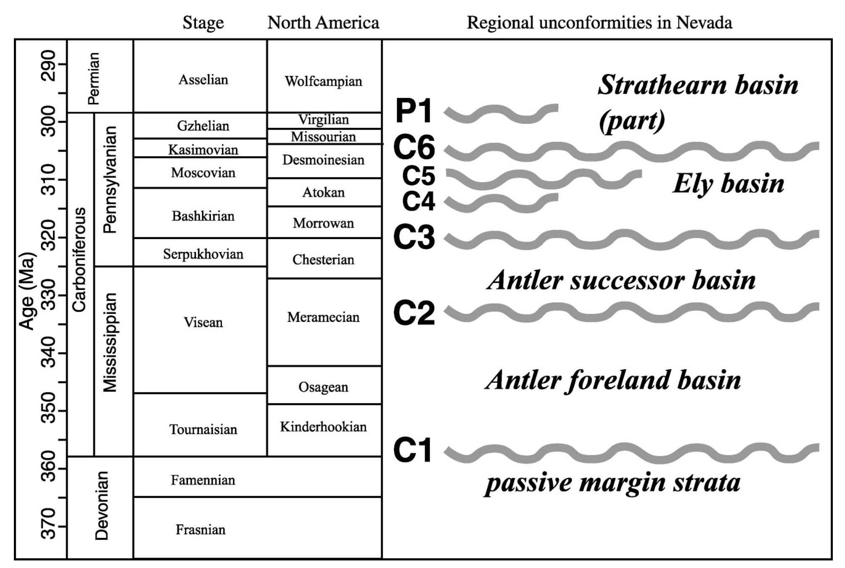
Widespread effects of middle Mississippian deformation in the Great Basin of western North America
Trexler et al., 2003
Presented by Luke J Schranz

Slide 2
Conventional interpretation of western NA:
2 Paleozoic orogenies
Observations indicate:
many angular unconformities, disconformities, and deformation in upper Paleozoic
Revision of stratigraphic nomenclature based on Paleozoic unconformities

Slide 3
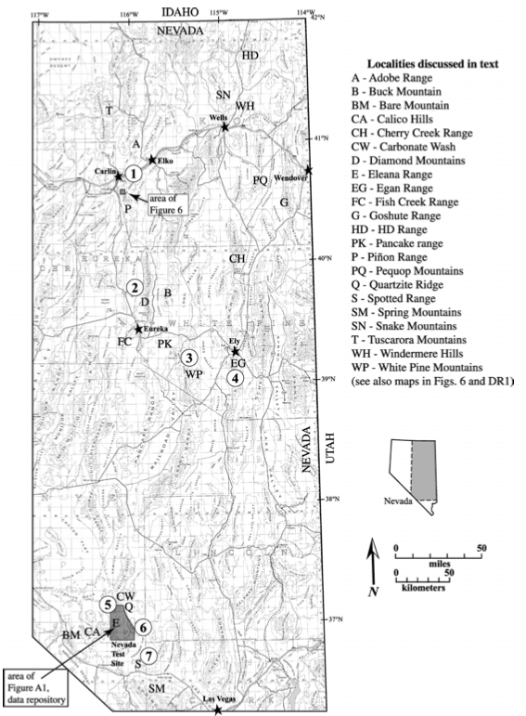
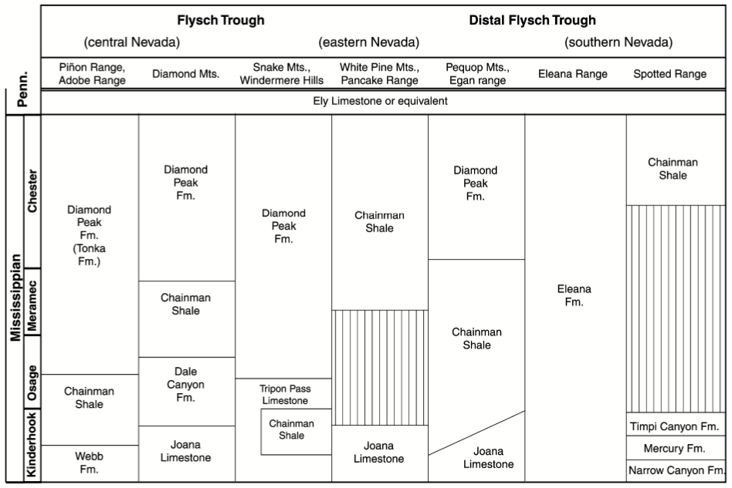

Slide 5
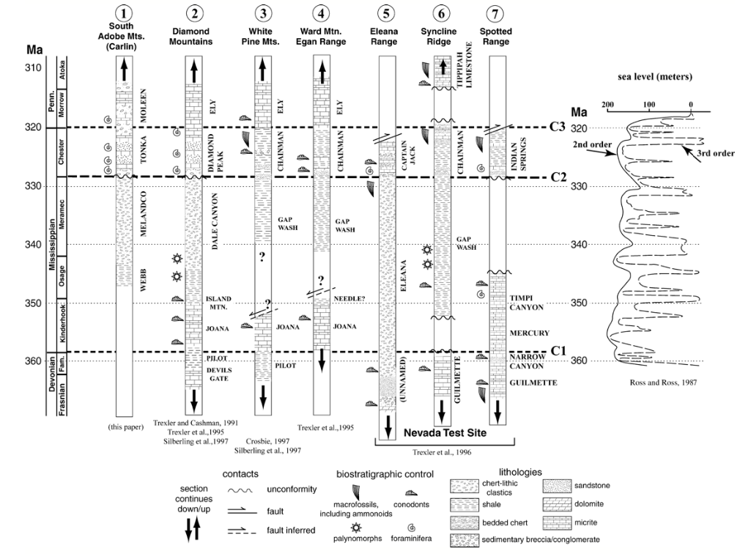
New terminology:
Abandons names were units contain regional unconformities
Selects formation names that are restrictive enough in thickness and extent that they also have relatively narrow age ranges

Slide 7
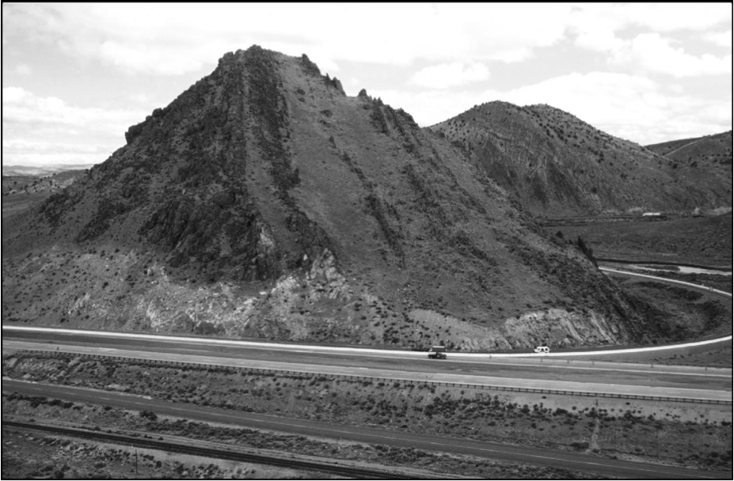
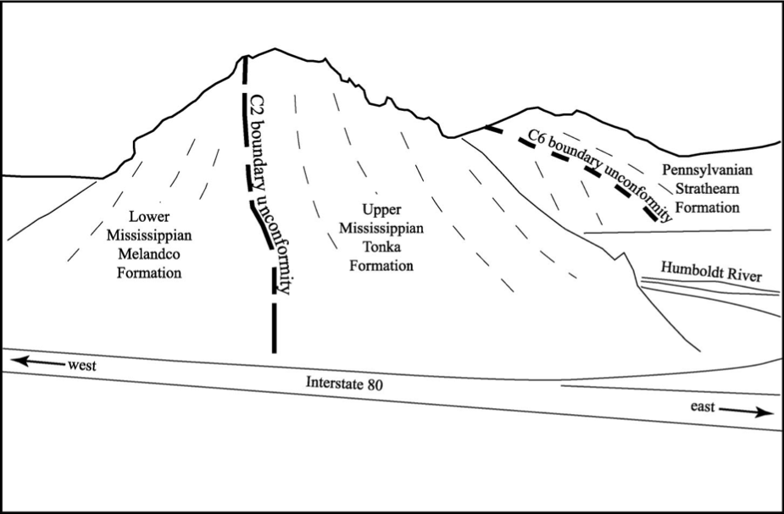

Slide 8
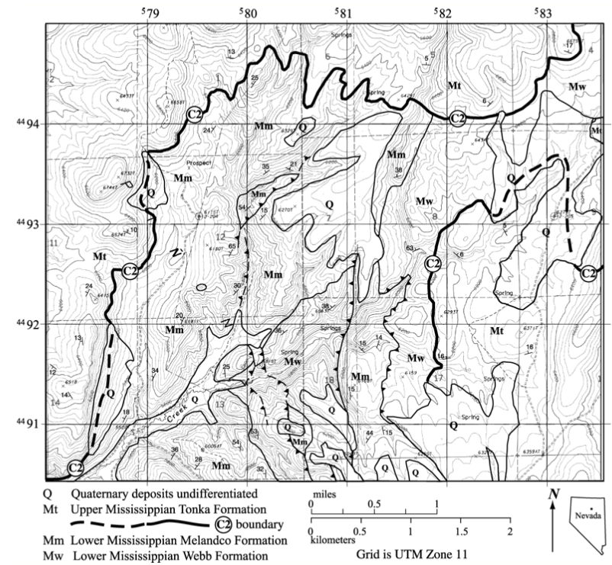
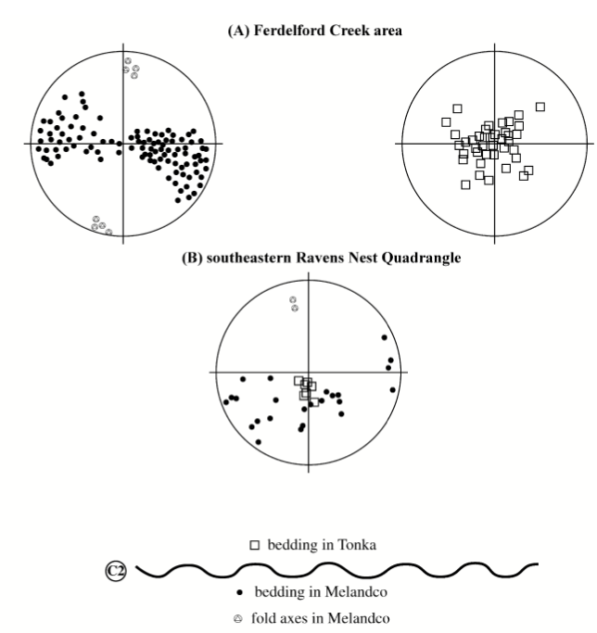
Antler or Roberts Mountains deformation?

